Slide 1
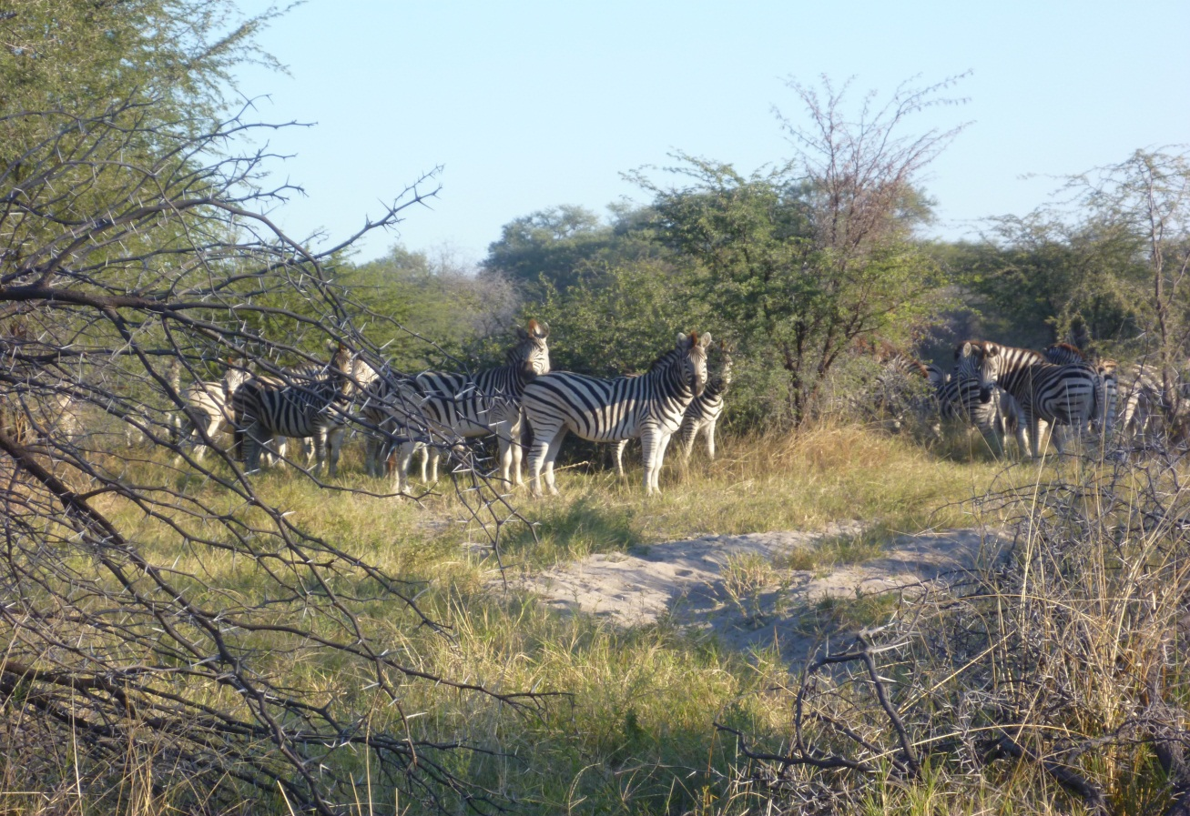

Are we all right?
Brian Mc Erlean MVB MRCVS
AVA Onelife Community Coordinator Suicide Prevention

Slide 2

Some facts
More people die through self harm in the Australian general population that in fatal motor vehicle accidents.
Veterinarians in 2 states (WA, VIC) and in the UK have at least 4 times the suicide rate of the general population.
Depression is common in male and female veterinarians but anxiety is more common in females.

Slide 3
Australian Survey Information
The Facts;
62.8% of veterinarians suffer non-specific psychological distress.
25.6% of veterinarians are depressed.
30.6% of veterinarians are stressed.
37% suffer personal burnout.
35.8% suffer work related burnout.
24.8% suffer client related burnout.
Note: These are overall percentages and are higher for those that graduated this century.
Ref: AVJ Nov 2011, Vol 89 No 11.

Slide 4

What gets us in trouble
Occupational stress factors are emerging as managerial aspects of the job
long working hours
heavy workload,
poor work-life balance
difficult client relations
performing euthanasia.
Some studies suggest that young and female veterinarians are at greatest risk of negative outcomes such as suicidal thoughts, mental health difficulties, and job dissatisfaction.

Slide 5
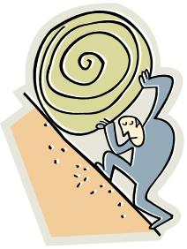
Long working hours
Exacerbated by small practice size, low fee structure and inefficient work practices.
The Whitehall study of civil servants in the UK suggests moving from an 8hr day to 11 hr. day more than doubles the likelihood of depression.

Slide 6
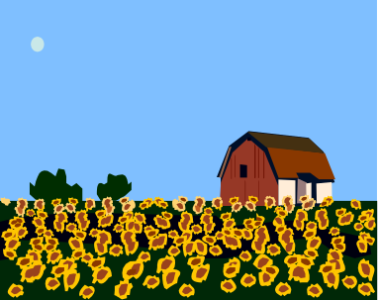
Cultural Change
Do we need to pick a different variety of seeds to plant in Veterinary Universities?
Do Universities need to tend the plants in a different manner? More practical graduates?
Are the plants going to wilt in practice due to isolation ( from friends families colleagues?) and poor watering (pay structures).
At the end of flowering life are the practice owners going to be able to sell their practices?

Slide 7

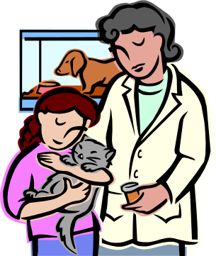
Difference between GPs and Veterinarians
GPs leave college and can set up in a shopping centre unit in the knowledge they do not have to build, equip and run a hospital.
GPs can have their bills paid by someone other than the patient. HBF Medicare.
If GPs specialise they are rewarded properly for their skills.

Slide 8

HAPPINESS
Joy and fulfilment in your life
Happiness is best brought about by five things:
Knowing yourself and using your 5 top character strengths each day
Friends and family
A job you enjoy
Doing voluntary work
Having a hobby ( where you do not feel the passage of time)

Slide 9

DEPRESSION
A state of dejection withdrawal sadness
Common in veterinary practice. Can be contributed to by long working hours and work pressure
Treatable with cognitive behavioural therapy with or without medication.
Meditation twice daily is beneficial.
Depression that becomes chronic and is left untreated can be a disaster for veterinarians.
Signs and symptoms can be obscure

Slide 10

ANXIETY
More common in female veterinarians.
Presence of unpredictability, uncertainty and uncontrollability all provoke anxiety automatically.
Extreme forms include obsessive compulsive behaviours and post traumatic stress disorders.
Can be treated by addressing the stressors and changing the way they are viewed.
Cognitive Behavioural Therapy is beneficial. Desensitisation to stressors is the aim.
Anxiolytic medications are getting better.

Slide 11

STRESS
Closely related to anxiety
Acute stress evolved as response to life threatening situations.
It is the fight, flight or fright response.
Cognitive Behavioural Therapy will help.
Many veterinarians endure chronic stress because they perceive elements of their work as threatening.

Slide 12
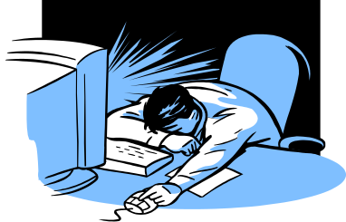
BURNOUT
Burnout is exhaustion the result of unrelieved mental strain. It can have physical emotional or psychological effects.
Long working hours and work pressure without relief are major contributors.
Manifestations include cynicism, perception that what you do is useless, the sense of achievement may be gone, there is no personal reward anymore.

Slide 13
What happens if we don’t change?
Relationship issues will simmer at home.
Depression in one person in a relationship often results in depression in the other.
Professional isolation will continue and just add to the disconnection and dislocation some veterinarians suffer.
Suicides and high depression rates will continue. To suicide an individual has to feel hopeless worthless helpless and have no control or have mental pathology that is untreated.

Slide 14

What is going on inside me?
Many of the mental states alluded to involve over function of the pituitary – hypothalamic pathways.
The body is flooded with adrenaline and cortisol. In some instances to the point of adrenal exhaustion.
Our bodies are not designed to deal with prolonged stress, anxiety and negativity.
Workplace stress can reduce life expectancy, depress the immune system and increase the incidence of chronic disease including cancer.

Slide 15
How do we deal with mental health issues until we can change the culture?
Develop Coping and Resilience skills.
These skills can be taught and learned and practised on a daily basis. Avail yourself of every opportunity available to learn these life skills.
Exercise diet and reducing alcohol intake all help.
Early intervention with depression is advisable. See a doctor for a physical check up and possibly Clinical Psychologist or qualified Counsellor to learn how to deal with it.

Slide 16

The Veterinary Dilemma
Starting salaries are low and veterinarians may be burdened with HECS, rent, car repayments in addition to tax and living expenses.
An experienced young veterinarian that decides to buy a partnership or share in a practice may feel considerable financial pressure if paying a mortgage and establishing a family at the same time. If this translates to more hours at work, problems may arise with mentation or relationships.
Juggling a family and a practice requires flexible working arrangements.

Slide 17

How do we change?
Stop normalising long working hours and poor professional remuneration.
Understand we are all part of the problem.
Reduce the corrosive aspects of competitive practice by working together.
Work hard at making veterinary undergraduates as practical as possible.
Develop coping and resilience skills.
Balance your life. Consider sport and participate in life outside your career.

Slide 18
Possible solutions in veterinary practice
Amalgamation of practices? The cartwheel in urban areas. Central headquarters and branch practices on the rim.
Increasing fees. ( fees may need to rise 20-30%)
Improve efficiency. Centralise expensive equipment and practice management.
Profitable practices can be sold. An unprofitable practice in a leased building may be very hard to sell.

Slide 19
For well being in society or Individuals
Positive approach
Engagement in life (something bigger than you)
Relationships (friends and family – work at it)
Meaning in life (have a purpose)
Achievement or accomplishment (that can be to learn a language or play a musical instrument)

Slide 20
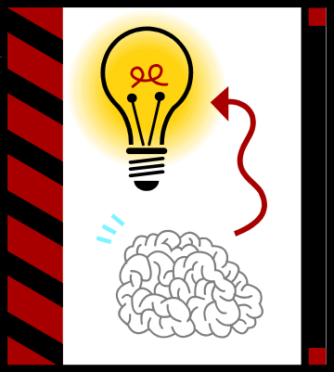
Recipe for Change
Breakdown professional isolation.
Encourage amalgamations.
Encourage group practices.
Reduce working hours.
Increase incomes.
Balance work and life.
Deal better with mistakes.

Slide 21
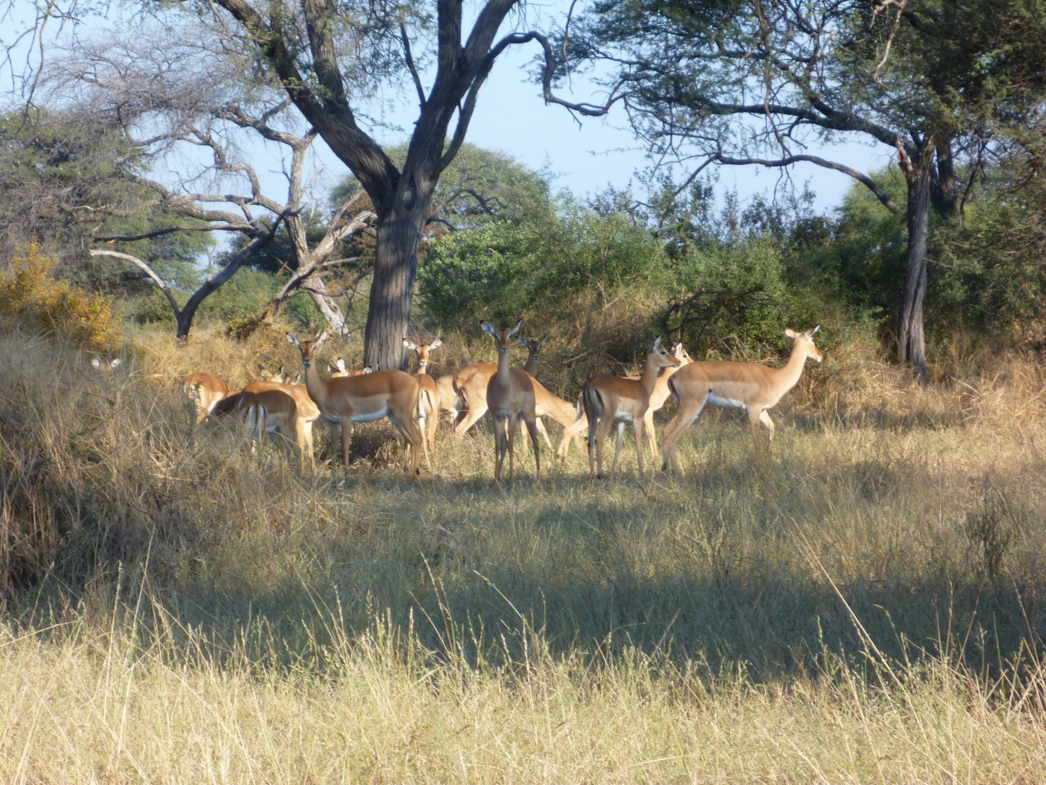
Contact Details
Brian Mc Erlean MVB MRCVS
Community Coordinator
nervoustransmitter@bigpond.com
+61 (0)4 3356 1922

